Slide 2
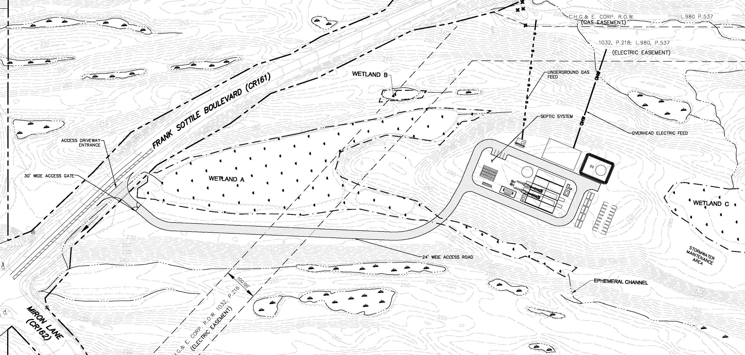
Are Power Plants Permitted Under the Town of Ulster’s Zoning Code?
We don’t think so!

Slide 3
OM District allows “utility company structures” as-of-right, and Glidepath says their project fits into this…
No definition of “utility company structure”
“Utility company structures” are permitted in every zoning district in Town with the sole exception of the Traditional Neighborhood Development Overlay District, including the most restrictive residential district in the Town (R-60)
The Town could not have intended this to include gas-fired power plants.

Slide 4
Zoning Must Be Consistent with Comprehensive Plan (NYS Town Law § 263)
Ulster’s 2007 Comprehensive Plan recommends adoption of Ridge Protection Overlay District that would encompass the Lincoln Park site, in order to preserve natural resources and scenic vistas.
This zoning was never adopted, but existing zoning must be interpreted consistent with the Comprehensive Plan.

Slide 5
In 2017 the Town considered adopting a moratorium on ground-mounted solar energy facilities
Stated reason: Solar energy facilities are not currently regulated by the Town’s zoning code.
Therefore, Town does not interpret commercial solar facilities to be “utility company structures”- and it should interpret fossil-fuel power plants the same way.

Slide 6
Action for Town of Ulster Residents
Send a letter to Town Supervisor and Town Board and demand that they publicly state whether they consider the Glidepath project a “utility company structure” permitted as-of-right in the OM zone as Glidepath has been claiming
AND
Request that the Town adopt a temporary moratorium on construction of power plants while it considers zoning that specifically regulates power plants

Slide 7
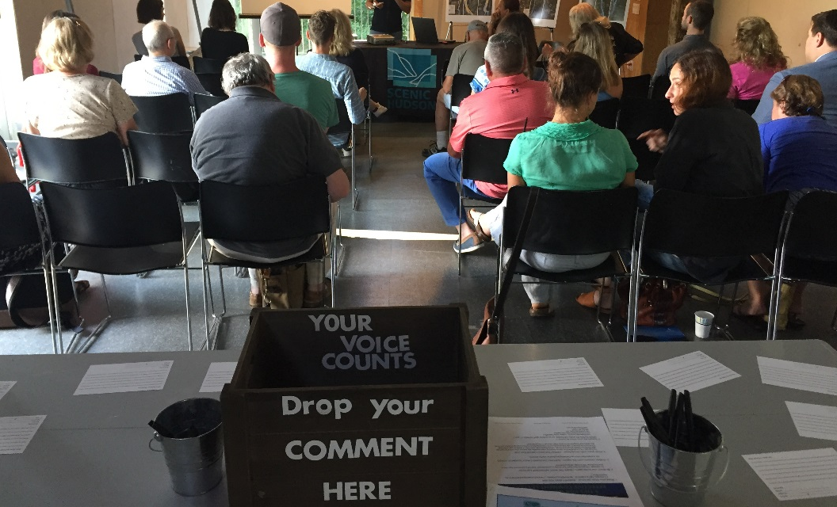
And if you don’t live in the Town of Ulster…
Ensure that your town doesn’t end up with a gas-fired power plant proposed just feet from a residential neighborhood!
Smaller “peaker” power plants that are primarily under jurisdiction of local governments — not New York State — are going to become increasingly prevalent throughout the Hudson Valley.
What can you do?
Most municipalities do not have zoning specifically regulating power plants.

Slide 8
Urge your municipality to place a moratorium on fossil-fuel burning power plants while they consider zoning that specifically addresses power plants!
Q. Should power plants be allowed at all in our town? Would prohibiting them constitute impermissible exclusionary zoning?
Not necessarily. NYS courts have stated that municipalities can ban industrial uses as long as prohibiting a use is a reasonable exercise of its police powers to prevent damage to the rights of others and to promote the interests of the community as a whole.
(Gernatt Asphalt Products v. Town of Sardinia)

Slide 9
If power plants are permitted in our town, how should our zoning regulate them? They should only be permitted:
In heavy industrial zones that are designated for uses that generate significant noise, traffic or pollutants and are far away from important environmental areas and residences;
With a special use permit;
Subject to strict conditions related to noise, stack height, etc.;
Subject to minimum lot size and coverage (subject to underlying zoning requirements or can create specific new standards); and
With an enforceable decommissioning plan requiring restoration of the site to original condition or better.

Slide 10
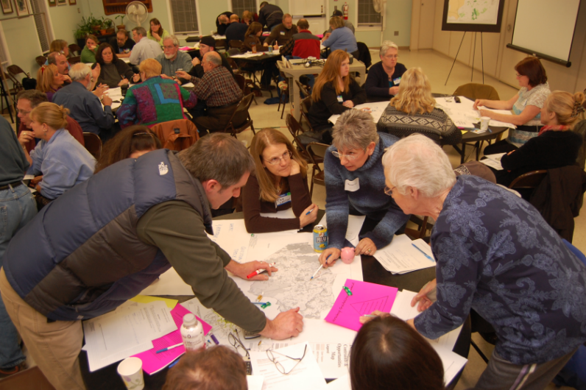
Lincoln Park SEQRA Process: Where Are We Now and What’s Next?
Glidepath is drafting its Draft Environmental Impact Statement (DEIS).
Lead Agency (Town Board) must find that DEIS is complete and adequate for public review and comment.
Once this decision is made, there will be a public comment period of a minimum of 30 days. The Lead agency may extend the comment period, on its own or upon request from the public. In practice, DEIS comment periods are often longer than 30 days.
There may be a public hearing on the DEIS, but not required.
Once the DEIS is released you can:
Request at least 90 days for public comment
Request at least one public hearing

