Slide 2
SEQRA as a Tool to Review Energy Projects
SEQRA’s mandate: Agencies must choose alternatives which, consistent with social, economic and other essential considerations, to the maximum extent practicable, minimize or avoid adverse environmental effects, including effects revealed in the environmental impact statement (EIS) process.

Slide 3
Project Description
Hybrid 20 MW gas fired power plant and battery storage facility
“Peaking” plant located on ~4 acres of a ~120 acre site
Will operate based on the needs of the electric grid but will be available to the grid 24 hours a day
Includes exhaust stack up to 80 feet tall and 50,000 diesel storage tank
Specifics of the proposed project are subject to change as a result of SEQR

Slide 4
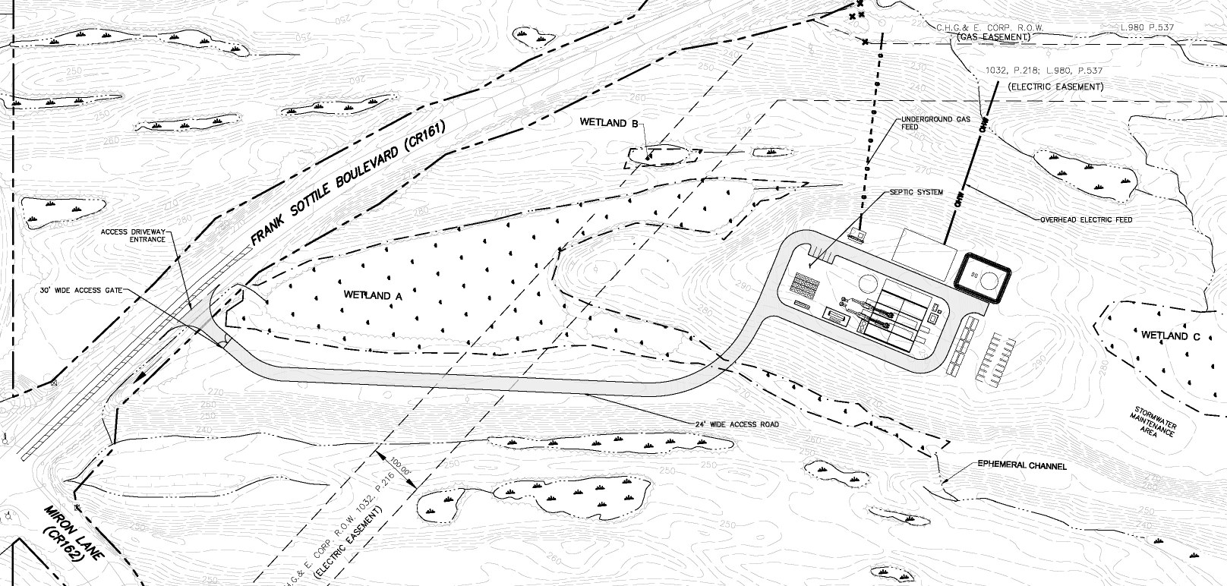

Slide 5
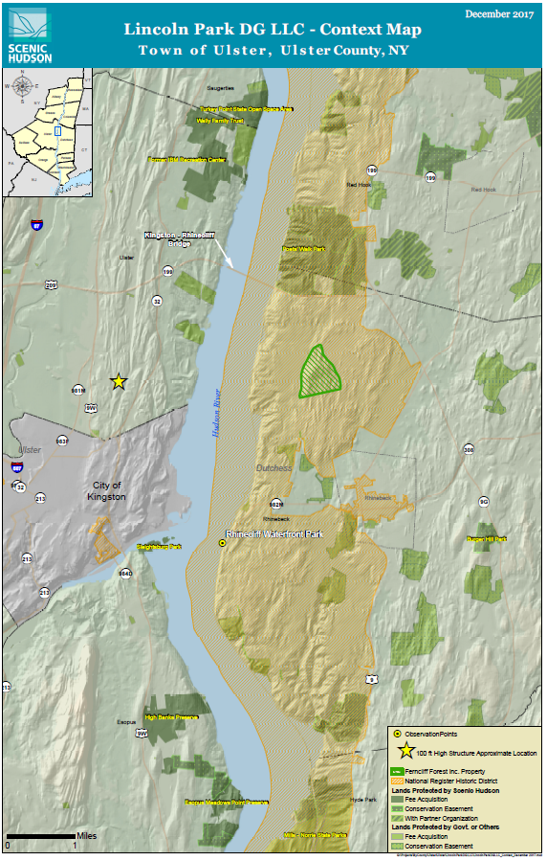
What’s at Risk?
Climate change and air emissions
Visual impacts
Water quality and wetlands
Cultural resources
Threatened/endangered species

Slide 6
SEQRA Process &
Ways to Get Involved

Slide 7
Approvals Required:
Federal – U.S. Fish and Wildlife Service (endangered species consultation), U.S. Army Corps of Engineers (wetlands disturbance permit)
State –Department of Environmental Conservation (SPDES general permit for stormwater discharges; petroleum bulk storage permit; air emissions permit, waste oil storage permit); OPRHP (consultation on historic and archeological resources)
Local – Town of Ulster (SEQRA lead agency, site plan approval); Town of Ulster Planning Board (lot line adjustment (consolidation)

Slide 8
Lincoln Park Grid Support Center: Regulatory Review – who’s in charge?
The Town of Ulster is the SEQR Lead Agency and has jurisdiction over the Site Plan approval for the project.
However, multiple approvals and permits are required, including from 2 Federal and 2 state agencies.
Before any permits can be granted, a full environmental review of all of the project’s environmental impacts is required, pursuant to SEQRA. SEQRA creates the record on which every permitting agency’s decisions must be based.

Slide 9
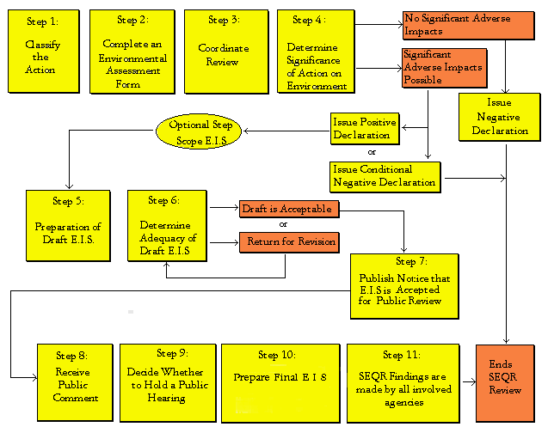

Slide 10
Where we are now
“[T]he Town Board . . . has identified several potentially significant adverse environmental impacts related to the Proposed Action, that needed to be thoroughly evaluated and mitigated, before taking any action;”
Step 4.
Positive Declaration Issued (February 1)
Scope Environmental Impact Statement (Public meeting Feb. 22; Comments due March 22)
Step 5.
Prepare Draft Environmental Impact Statement

Slide 11
Next Steps in the SEQR Process
Draft scope (the detailed table of contents for the Draft Environmental Impact Statement) released February 1. Public scoping session on February 22; Comments due by March 22.
Because the opportunity for public input on the scope is limited, it is important to get ready to comment now. Identification of local impacts of concern to your town, its businesses and residents will be particularly important.

Slide 12
Scoping
YOUR chance to identify potential local impacts & community resources that the lead agencies may not be aware of.
Identify potential impacts of concern
Water/air quality, wetlands, open space, recreational resources, climate change, fish and wildlife, culture, economics, and public health.
Describe the significance
And define the breadth of study necessary to address the impact’s significance in terms of time, geography and populations affected.
Identify alternative(s) to the project
Include different locations, size or technologies and other courses of action.

Slide 13
Scoping Comments
Focus on Local Impacts That You Think Should be Studied
Potential impacts to wetlands and principal aquifer
Impact of carbon and other emissions on global climate change, NYS policy and local air quality and public health
Stormwater runoff impacts
Visual impacts locally and within the Hudson River National Landmark Historic District and Estates District Scenic Area of Statewide Significance
Potential impacts to threatened and endangered species
Cultural resource impacts, including Native American archeological sites
Potential inconsistency with Town Comprehensive Plan

Slide 14
Where do we go from here?
The Environmental Review Process - SEQR:
Stay involved in the environmental review process. Attend the public scoping session on February 22 and submit written comments on the draft scope by March 22, emphasizing what local, as well as regional and global, impacts must be considered and alternatives that should be evaluated.
Contact your county and state officials and ask them to prepare for the environmental review process and submission of their own comments
State Dept. of Environmental Conservation permits:
Comment on draft permits when released by DEC

Slide 15
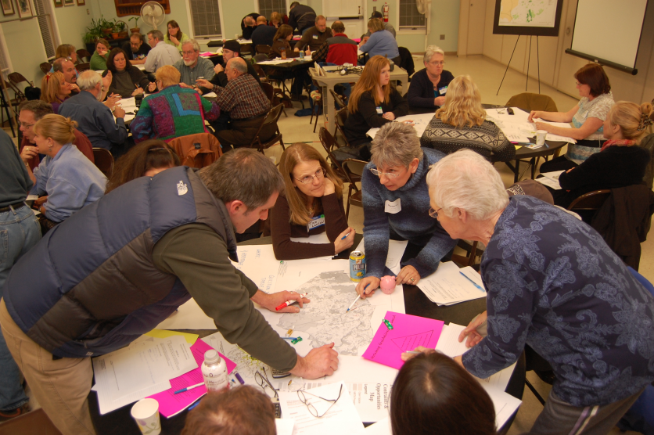
More ways to get involved…
Sign Up for Updates
Kingston Citizens, Scenic Hudson, Riverkeeper , Citizens for Local Power , Catskill Mountainkeeper & the Coalition Against Pilgrim Pipelines-NY
Attend Public Meetings and Public Scoping Session on February 22
Submit Comments to the Town of Ulster by March 22
Contact Elected Officials

Slide 16
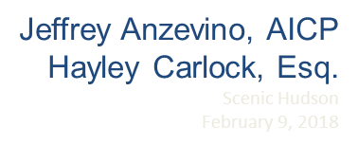
Questions?

