Slide 1
Living in the G Zone: State Rules and the Proposed Lincoln Park Project
Evelyn Wright, Energy Analyst
Sustainable Energy Economics and Citizens for Local Power
August 10, 2018

Slide 2
Presentation outline
Why is Glidepath proposing this plant, with this design, here?
What’s happening with storage in New York State?
What about alternatives to this project design?
And what does this all mean for the rest of the region?

Slide 3
How power plants in New York get paid
Energy market
Plants get paid for generating kwh for consumption
Capacity market
Plants get paid for guaranteeing that they have capacity available to be called upon to meet additional demand
Currently they have to guarantee availability for at least 4 hours
Ancillary services
Plants get paid for turning up and down quickly to maintain power quality

Slide 4
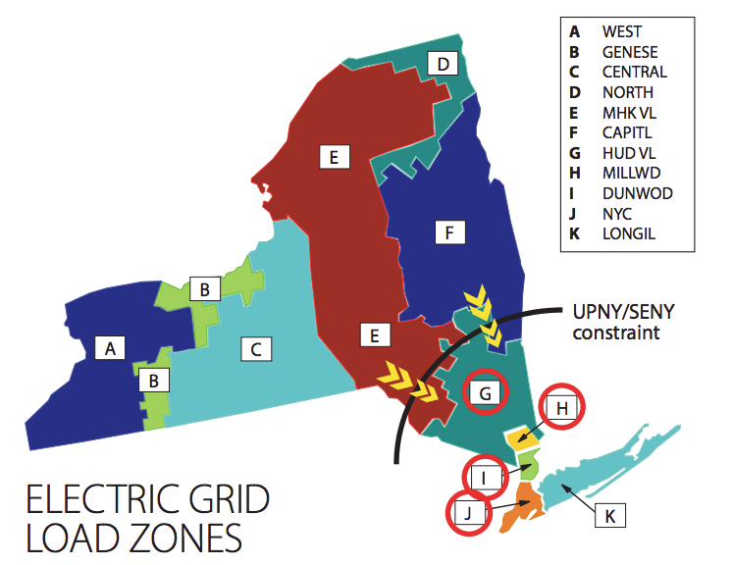
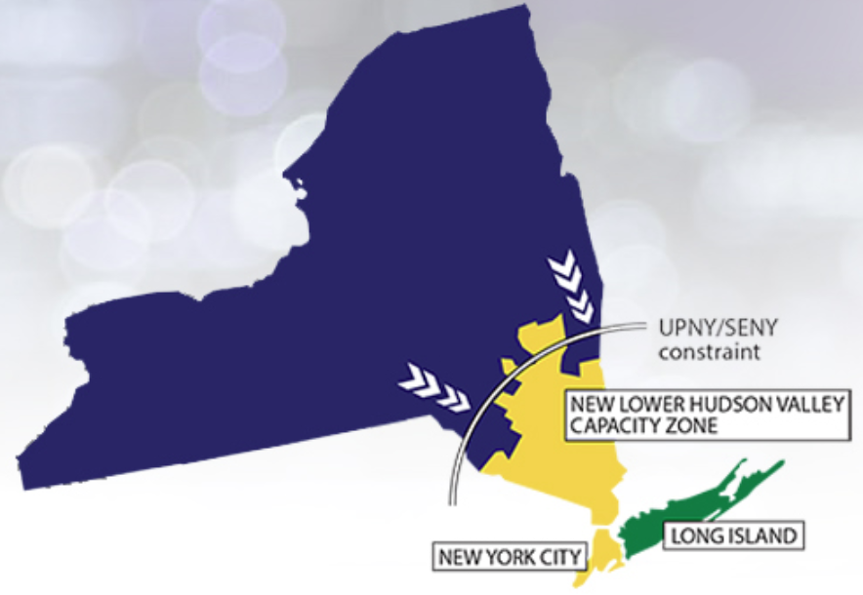
New York Capacity Zones
In 2014, Zone G was grouped with the other downstate zones in the New Capacity Zone
How much plants get paid depends on the zone they’re in
$3.88/kW
$9.58/kW
$9.58/kW
$6.68/kW
Capacity values in our Zone are 2-3 times higher than further upstate

Slide 5
Capacity market rules
The purpose of the capacity market is to ensure that enough capacity is available to meet unexpected demands
Either because a generator or transmission line goes down, or because demand is unexpectedly high
So market participants need to guarantee their availability if called upon
The current rules require them to be available for at least four continuous hours, making it impractical for a 4-hour battery to participate
The Federal Energy Regulatory Commission has mandated that all system operators (including NYISO) write new rules appropriate for battery-only projects
NYISO plans to have them out in late 2019 or 2020

Slide 6
Is the new capacity zone here to stay?
In 2017, NYISO directed its staff to design a process for eliminating capacity zones, if needed
But in 2018, the NYISO board decided that only having a process for creating zones was good enough
Central Hudson filed and lost an appeal, but will probably try again
Notes:
NYISO board decision at http://www.nyiso.com/public/webdocs/markets_operations/committees/appeals/appeals_to_the_bod/February_28,_2018/NYISO-board-decision-re-on-ramp-off-ramp.pdf

Slide 7
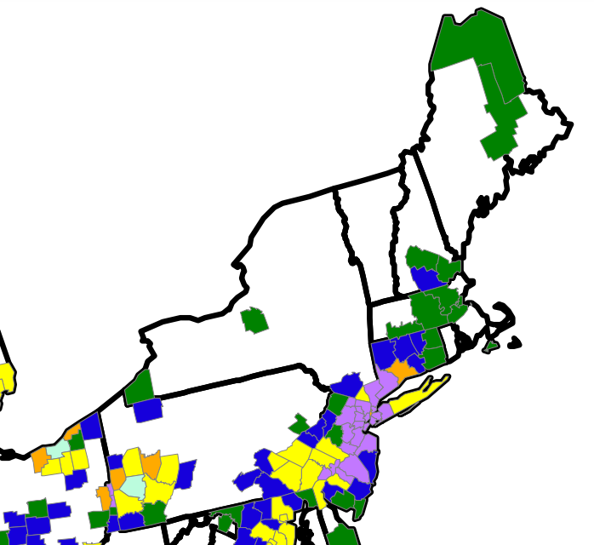
What about air permits?
Air sources are classified as minor or major
Major sources have more complex permitting requirements and ongoing reporting requirements, and are federally enforceable
The thresholds for minor vs. major are higher in areas that have attained their air quality standards
It is easier to get a permit in areas with cleaner air
EPA map of nonattainment areas

Slide 8
Is there a “need” for plants like this?
Glidepath will point to the capacity payment values in our zone as evidence that the market is “calling for” plants like this
But as we’ve seen, this market is a human construct. Payment values are high because of how the market is set up.
As more renewables come on the system, eventually it will need more flexibility
But there are lots of ways to get flexibility, such as storage-only and smart loads, like EV charging

Slide 9
What’s coming in the New York storage market?
Storage technology continues to improve!
NYISO storage rule changes expected next year
New York storage goals and roadmap

Slide 10
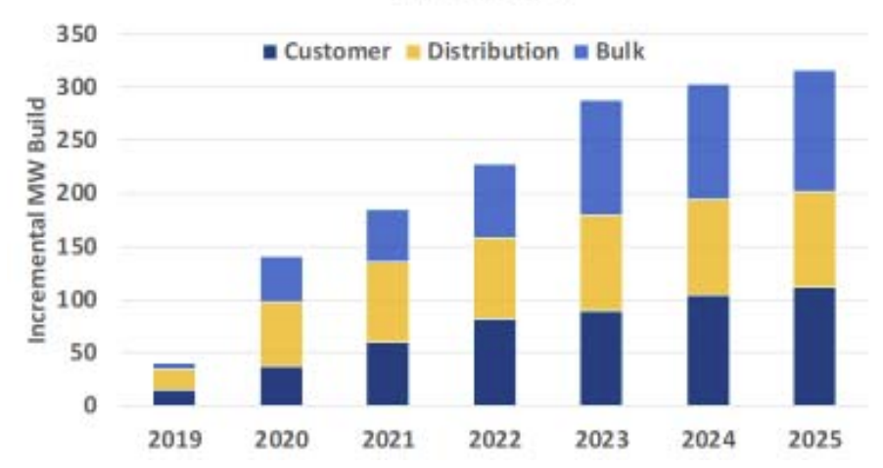
New York Storage Roadmap
Governor Cuomo has set the most ambitious storage goals in the country: 1500 MW by 2025
NYSERDA has translated this into targets and has $350 million to spend
The Public Service commission will release program rules later this year
MW built per year targets
Glidepath wants to build on the “Bulk” system, which NYSERDA believes will start to take off in 2020

Slide 11
Alternatives to this project design – at other sites
Serve the distribution system: Non-wires alternatives
ConEd is actively looking for storage developers for projects downstate
Hybridize existing peaker plants
NYS has 3000 MW of very old, very dirty peaker plants that need to make changes to meet new air regulations (again mostly downstate)
Partner with an industrial or commercial site that can use some of the batteries’ services

Slide 12
Alternatives to this project design – at this site
Storage-plus-renewables
Renewables do not have to be co-located on the same site in order to get state incentives!
Storage only
Actively participate in the evolving NYISO and NYSERDA/PSC processes that will change the storage market landscape over the next two years
Design a storage only project that benefits from those incentives

Slide 13
Meanwhile, in the G Zone…
All communities in this region are vulnerable to proposals like this one
What can we do?
Individual communities can make sure their zoning is ready and appropriate for facilities like this
Stakeholder groups can get involved in the NYISO rulemaking processes
Notes:
Information about being an official NYISO stakeholder committee member is here: http://www.nyiso.com/public/webdocs/markets_operations/committees/general_information/Committee_FAQs_2017.pdf

